Slide 1
Logic Circuits Design presented by Amr Al-Awamry
Notes:
Give qualifications of instructors:
DAP
teaching computer architecture at Berkeley since 1977
Co-athor of textbook used in class
Best known for being one of pioneers of RISC
currently author of article on future of microprocessors in SciAm Sept 1995
RY
took 152 as student, TAed 152,instructor in 152
undergrad and grad work at Berkeley
joined NextGen to design fact 80x86 microprocessors
one of architects of UltraSPARC fastest SPARC mper shipping this Fall

Slide 2
Overview
Magnitude comparators
Compare two multi-bit binary numbers
Create a single bit comparator
Use repetitive pattern
Multiplexers
Select one out of several bits
Some inputs used for selection
Also can be used to implement logic
Binary decoders
Converts an n-bit code to a single active output
Can be developed using AND/OR gates
Can be used to implement logic circuits.
Binary encoders
Converts one of 2^{n} inputs to an n-bit output
Useful for compressing data
Can be developed using AND/OR gates
Notes:
credential:
bring a computer
die photo
wafer
:
This can be an hidden slide. I just want to use this to do my own planning.
I have rearranged Culler’s lecture slides slightly and add more slides. This covers everything he covers in his first lecture (and more) but may
We will save the fun part, “ Levels of Organization,” at the end (so student can stay awake): I will show the internal stricture of the SS10/20.
Notes to Patterson: You may want to edit the slides in your section or add extra slides to taylor your needs.

Slide 3
Magnitude Comparator
The comparison of two numbers
outputs: A>B, A=B, A<B
Design Approaches
the truth table
2^{2n} entries - too cumbersome for large n
use inherent regularity of the problem
reduce design efforts
reduce human errors
A < B
A[3..0]
Magnitude
Compare
A = B
B[3..0]
A > B

Slide 4
Magnitude Comparator
How can we find A > B?
How many rows would a truth table have?
2⁸ = 256

Slide 5
Magnitude Comparator
Find A > B
Because A3 > B3
i.e. A3 . B3’ = 1
If A = 1001 and
B = 0111
is A > B?
Why?
Therefore, one term in the
logic equation for A > B is
A3 . B3’

Slide 6
Magnitude Comparator
If A = 1010 and
B = 1001
is A > B?
Why?
A > B = A3 . B3’
+ C3 . A2 . B2’
+ …..
Because A3 = B3 and
A2 = B2 and
A1 > B1
i.e. C3 = 1 and C2 = 1 and
A1 . B1’ = 1
Therefore, the next term in the
logic equation for A > B is
C3 . C2 . A1 . B1’

Slide 7
Magnitude Comparison
Algorithm -> logic
A = A₃A₂A₁A₀ ; B = B₃B₂B₁B₀
A=B if A₃=B₃, A₂=B₂, A₁=B₁and A₁=B₁
Test each bit:
equality: x_{i}= A_{i}B_{i}+A_{i}'B_{i}'
(A=B) = x₃x₂x₁x₀
More difficult to test less than/greater than
(A>B) = A₃B₃'+x₃A₂B₂'+x₃x₂A₁B₁'+x₃x₂x₁ A₀B₀'
(A<B) = A₃'B₃+x₃A₂'B₂+x₃x₂A₁'B₁+x₃x₂x₁ A₀'B₀
Start comparisons from high-order bits
Implementation
x_{i} = (A_{i}B_{i}'+A_{i}'B_{i})’

Slide 8
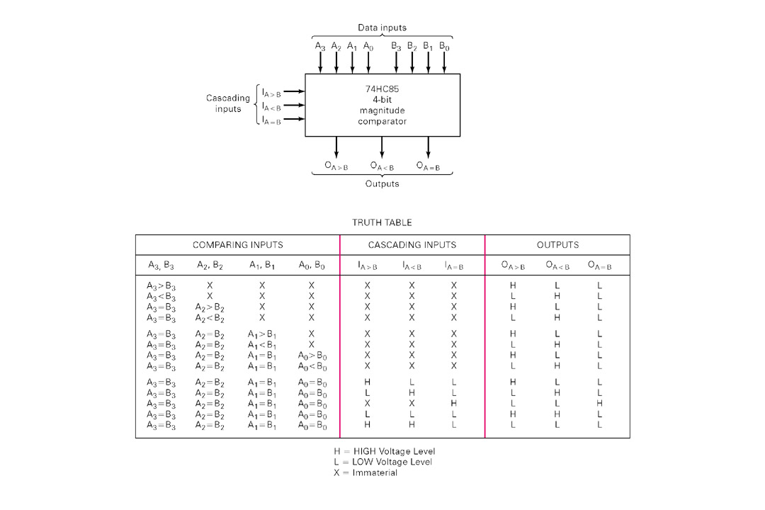
Magnitude Comparison
Hardware chips

Slide 9
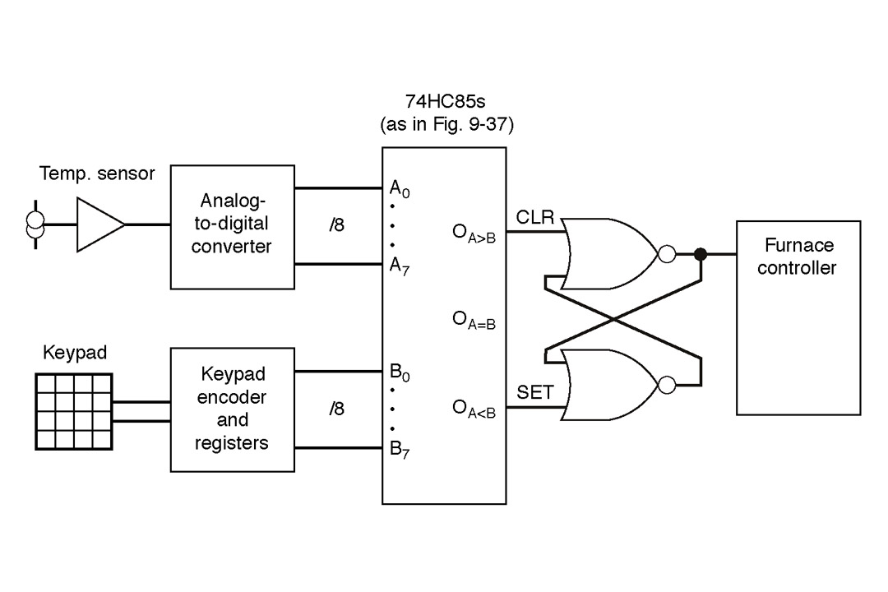
Magnitude Comparator
Real-world application
Thermostat controller

Slide 10
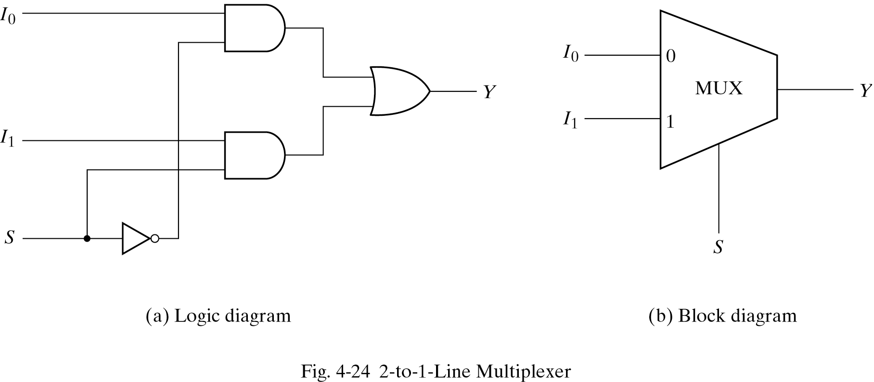
Multiplexers
Select an input value with one or more select bits
Use for transmitting data
Allows for conditional transfer of data
Sometimes called a mux

Slide 11
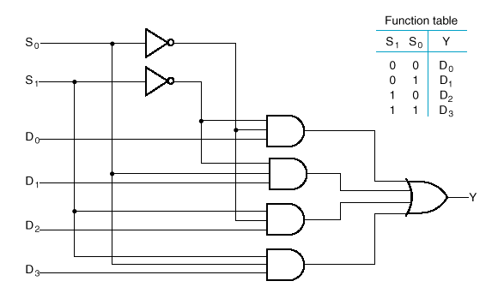
4– to– 1- Line Multiplexer

Slide 12
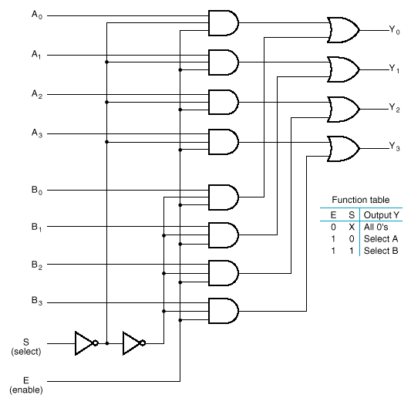
Quadruple 2–to–1-Line Multiplexer
Notice enable bit
Notice select bit
4 bit inputs

Slide 13
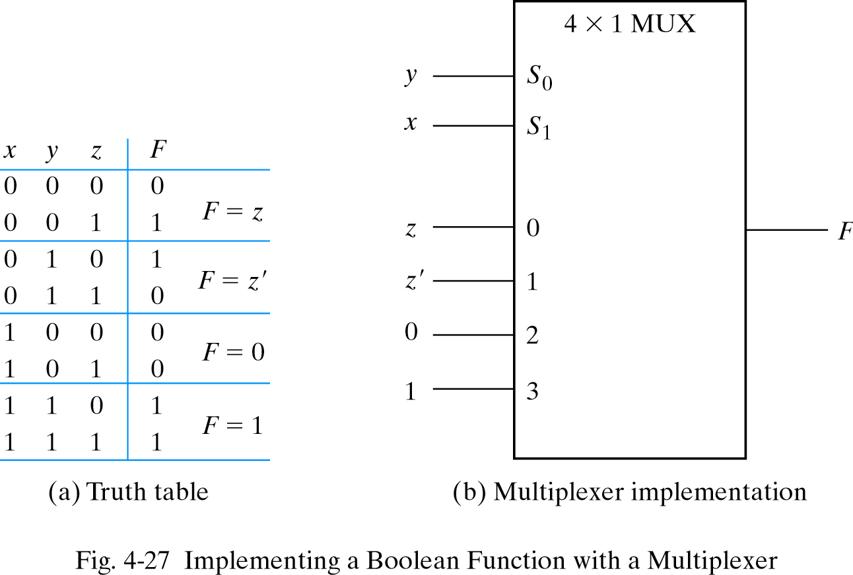
Multiplexer as combinational modules
Connect input variables to select inputs of multiplexer (n-1 for n variables)
Set data inputs to multiplexer equal to values of function for corresponding assignment of select variables
Using a variable at data inputs reduces size of the multiplexer

Slide 14
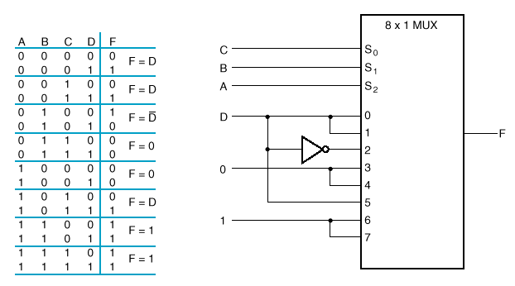
Implementing a Four- Input Function with a Multiplexer

Slide 15
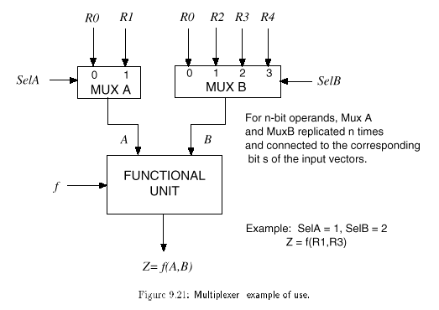
Typical multiplexer uses

Slide 16
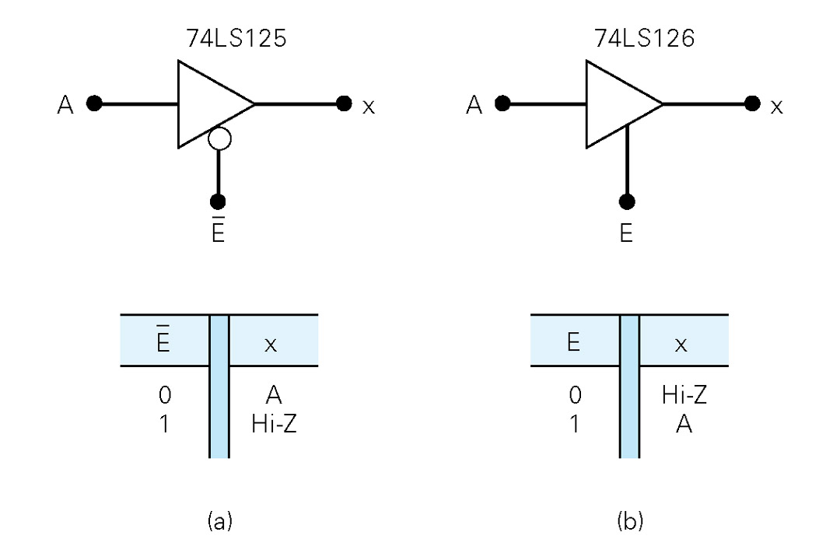
Three-state gates
A multiplexer can be constructed with three-state gates
Output state: 0, 1, and high-impedance (open ckts)
If the select input (E) is 0, the three-state gate has no output
Opposite true here,
No output if E is 1

Slide 17
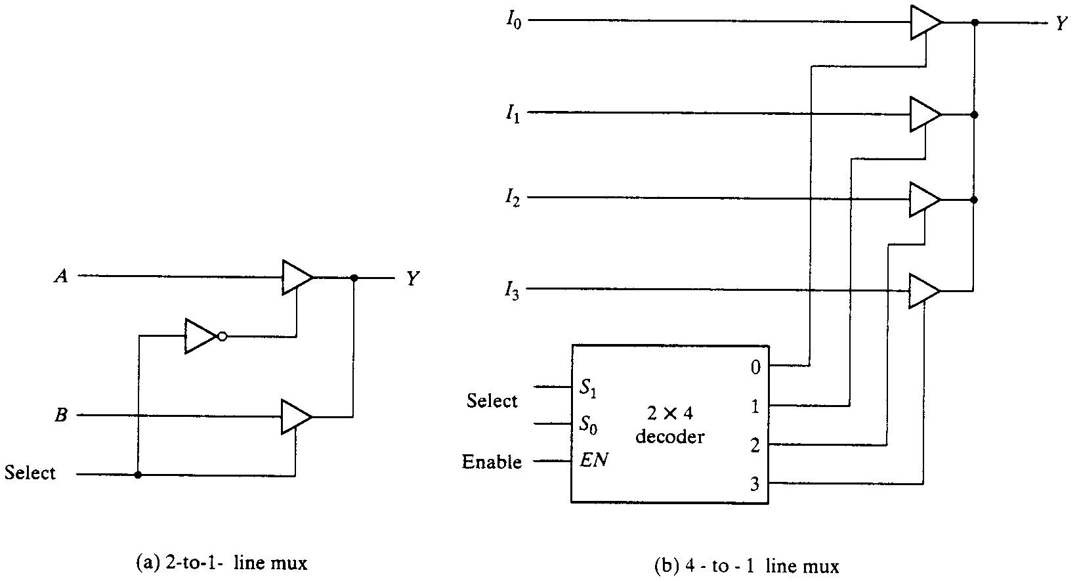
Three-state gates
A multiplexer can be constructed with three-state gates
Output state: 0, 1, and high-impedance (open ckts)
If the select input is low, the three-state gate has no output

Slide 18
Binary Decoder
Black box with n input lines and 2^{n} output lines
Only one output is a 1 for any given input
Binary
Decoder
n
inputs
2^{n} outputs

Slide 19
2-to-4 Binary Decoder
Truth Table:
F₀ = X'Y'
F₁ = X'Y
From truth table, circuit for 2x4 decoder is:
Note: Each output is a 2-variable minterm (X'Y', X'Y, XY' or XY)
F₂ = XY'
F₃ = XY
F0
F1
F2
F3
X
Y
X
2-to-4
Decoder
Y

Slide 20
3-to-8 Binary Decoder
Truth Table:
F₀ = x'y'z'
F₁ = x'y'z
F₂ = x'yz'
F₃ = x'yz
F₄ = xy'z'
F₅ = xy'z
F₆ = xyz'
F0
F1
F2
F3
F4
F5
F6
F7
F₇ = xyz
X
3-to-8
Decoder
Y
Z
x
y
z

Slide 21
Implementing Functions Using Decoders
Any n-variable logic function can be implemented using a single n-to-2^{n} decoder to generate the minterms
OR gate forms the sum.
The output lines of the decoder corresponding to the minterms of the function are used as inputs to the or gate.
Any combinational circuit with n inputs and m outputs can be implemented with an n-to-2^{n} decoder with m OR gates.
Suitable when a circuit has many outputs, and each output function is expressed with few minterms.

Slide 22
Implementing Functions Using Decoders
Example: Full adder
S(x, y, z) = Σ (1,2,4,7)
C(x, y, z) = Σ (3,5,6,7)
3-to-8
Decoder
0
1
2
3
4
5
6
7
S
x
S₂
S₁
S₀
y
z
C

Slide 23
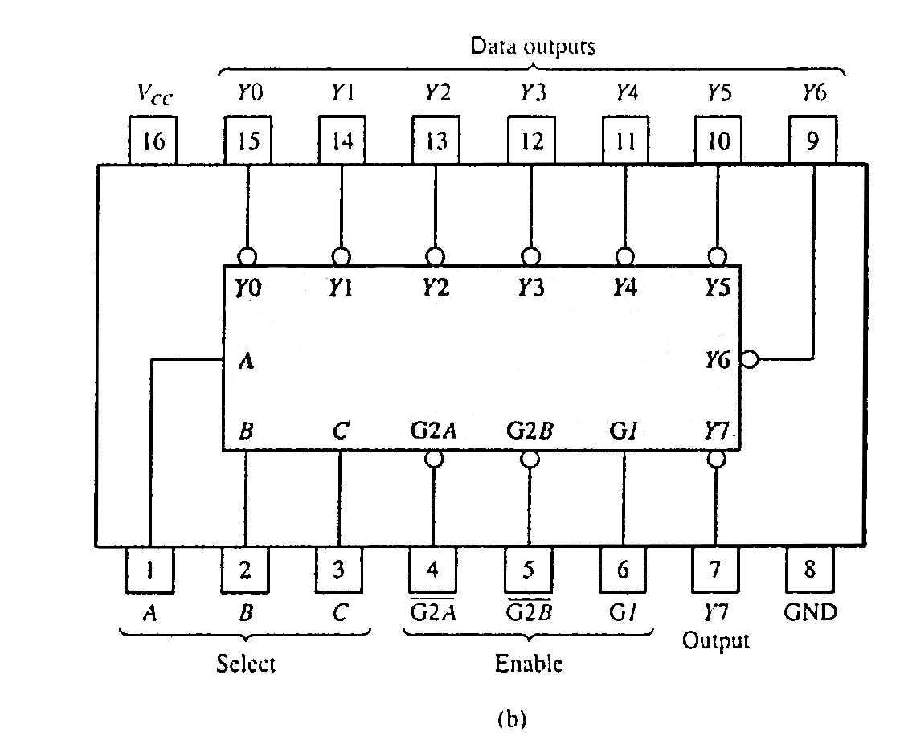
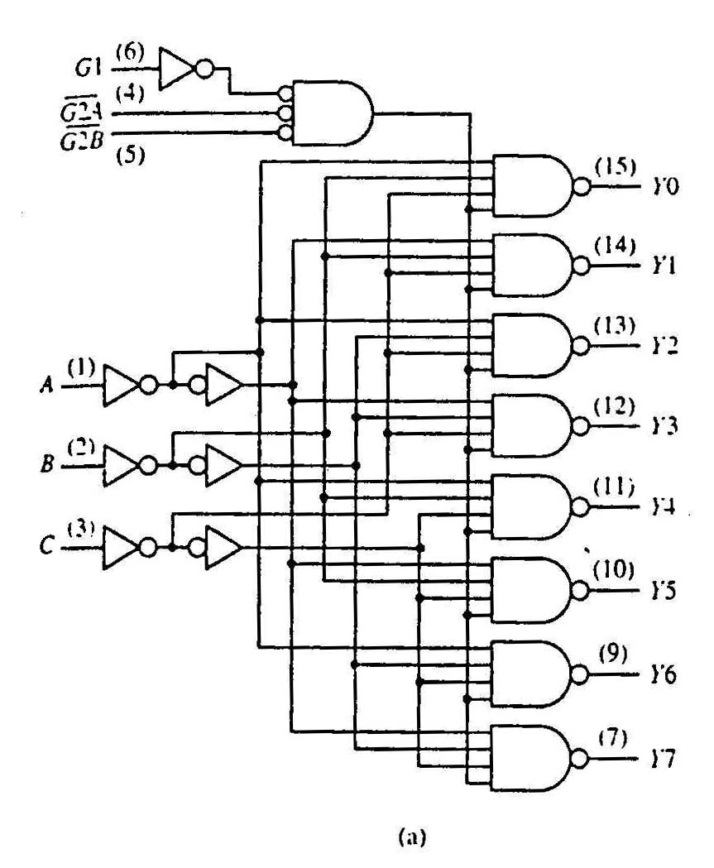
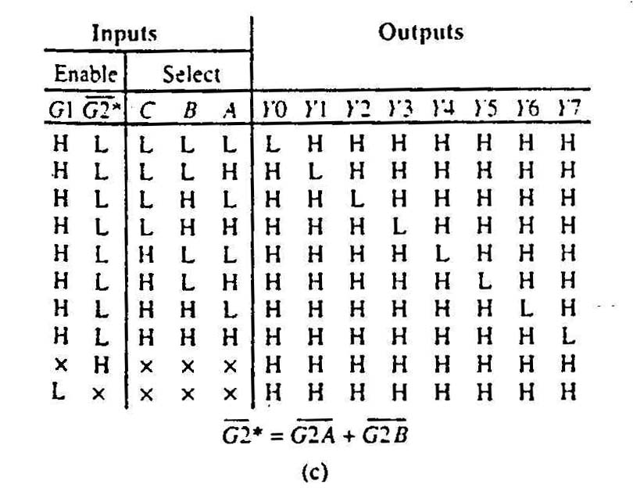
Standard MSI Binary Decoders Example
74138 (3-to-8 decoder)
(a) Logic circuit.
(b) Package pin configuration.
(c) Function table.

Slide 24
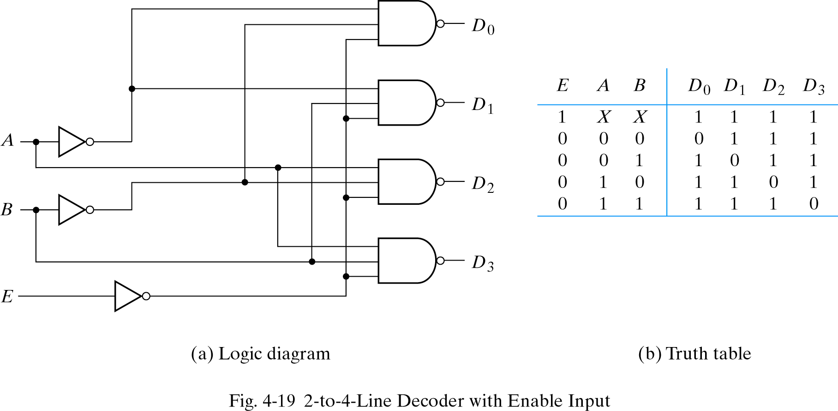
Building a Binary Decoder with NAND Gates
Start with a 2-bit decoder
Add an enable signal (E)
Note: use of NANDs
only one 0 active!
if E = 0

Slide 25
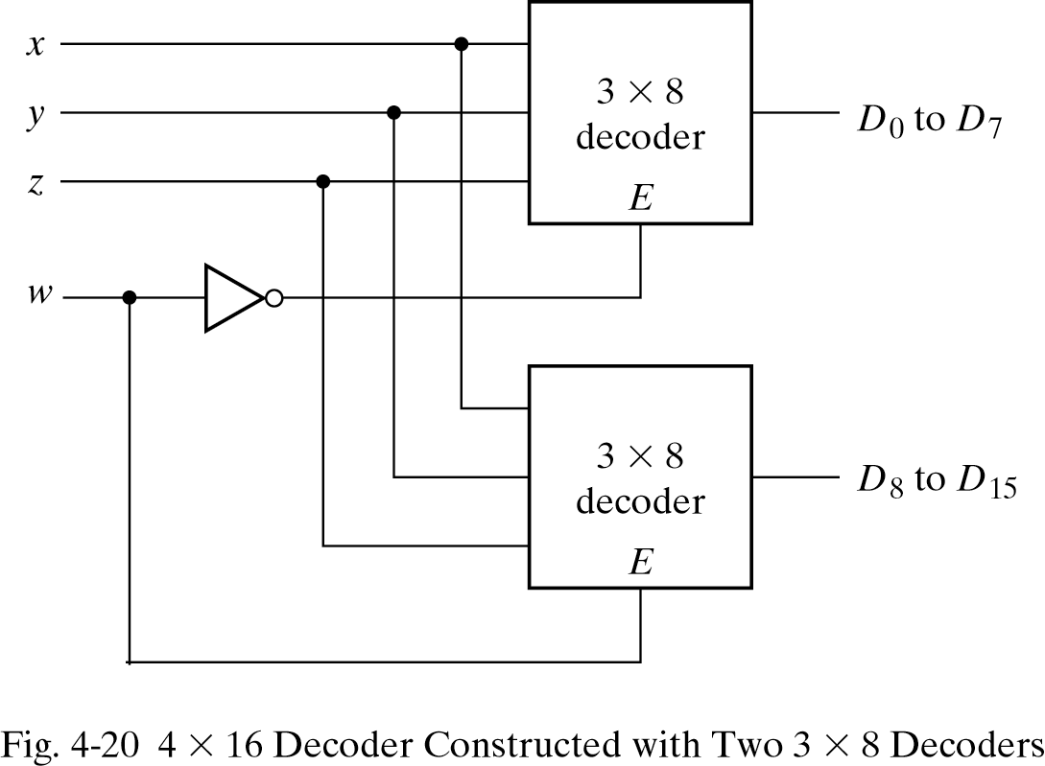
Use two 3 to 8 decoders to make 4 to 16 decoder
Enable can also be active high
In this example, only one decoder can be active at a time.
x, y, z effectively select output line for w

Slide 26
Encoders
If the a decoder's output code has fewer bits than the input code, the device is usually called an encoder.
e.g. 2^{n}-to-n
The simplest encoder is a 2^{n}-to-n binary encoder
One of 2^{n} inputs = 1
Output is an n-bit binary number
Binary
encoder
2^{n}
inputs
n
outputs
.
.
.
.
.
.

Slide 27
8-to-3 Binary Encoder
At any one time, only
one input line has a value of 1.
Inputs
Outputs
I
0
I
1
I
2
I
3
I
4
I
5
I
6
I
7
y₂
y₁
y₀
1
0
0
0
0
0
0
0
0
0
0
0
1
0
0
0
0
0
0
0
0
1
0
0
1
0
0
0
0
0
0
1
0
0
0
0
1
0
0
0
0
0
1
1
0
0
0
0
1
0
0
0
1
0
0
0
0
0
0
0
1
0
0
1
0
1
0
0
0
0
0
0
1
0
1
1
0
0
0
0
0
0
0
0
1
1
1
1
I₀
I₁
I₂
I₃
I₄
I₅
I₆
I₇
y₂ = I₄ + I₅ + I₆ + I₇
y₁ = I₂ + I₃ + I₆ + I₇
y₀ = I₁ + I₃ + I₅ + I₇

Slide 28
8-to-3 Priority Encoder
What if more than one input line has a value of 1?
Ignore “lower priority” inputs.
Idle indicates that no input is a 1.
Note that polarity of Idle is opposite from Table 4-8 in Mano
Inputs
Outputs
I
0
I
1
I
2
I
3
I
4
I
5
I
6
I
7
y₂
y₁
y₀ Idle
0
0
0
0
0
0
0
0
x
x
x 1
1
0
0
0
0
0
0
0
0
0
0 0
X
1
0
0
0
0
0
0
0
0
1 0
X
X
1
0
0
0
0
0
0
1
0 0
X
X
X
1
0
0
0
0
0
1
1 0
X
X
X
X
1
0
0
0
1
0
0 0
X
X
X
X
X
1
0
0
1
0
1 0
X
X
X
X
X
X
1
0
1
1
0 0
X
X
X
X
X
X
X
1
1
1
1 0

Slide 29
Priority Encoder (8 to 3 encoder)
Assign priorities to the inputs
When more than one input are asserted, the output generates the code of the input with the highest priority
Priority Encoder : H7=I7 (Highest Priority) H6=I6.I7’ H5=I5.I6’.I7’ H4=I4.I5’.I6’.I7’ H3=I3.I4’.I5’.I6’.I7’ H2=I2.I3’.I4’.I5’.I6’.I7’ H1=I1. I2’.I3’.I4’.I5’.I6’.I7’ H0=I0.I1’. I2’.I3’.I4’.I5’.I6’.I7’ IDLE= I0’.I1’. I2’.I3’.I4’.I5’.I6’.I7’
Encoder Y0 = I1 + I3 + I5 + I7 Y1 = I2 + I3 + I6 + I7 Y2 = I4 + I5 + I6 + I7
Priority encoder
Priority Circuit
Binary encoder
I0
I0
H0
I0
I1
I1
H1
I1
I2
I2
H2
I2
Y0
Y0
I3
I3
H3
I3
Y1
Y1
I4
I4
H4
I4
Y2
Y2
I5
I5
H5
I5
I6
I6
H6
I6
I7
I7
H7
I7
IDLE
IDLE

Slide 30
Encoder Application (Monitoring Unit)
Encoder identifies the requester and encodes the value
Controller accepts digital inputs.
Alarm Signal
Contoller Response
Machine 1
Machine 2
Machine Code
Action
Encoder
Controller
Machine n

